Slide 1
HARDWARE
2
Chapter

Slide 2
Chapter Topics
4.1 The System Unit: The Basics
4.2 More on the System Unit: What Supports the
Processor?
4.3 Secondary Storage
4.4 Input & Output
4.5 Input Hardware
4.6 Output Hardware
4.7 The Future of Input & Output

Slide 3
4.1 The System Unit: The Basics

Slide 4
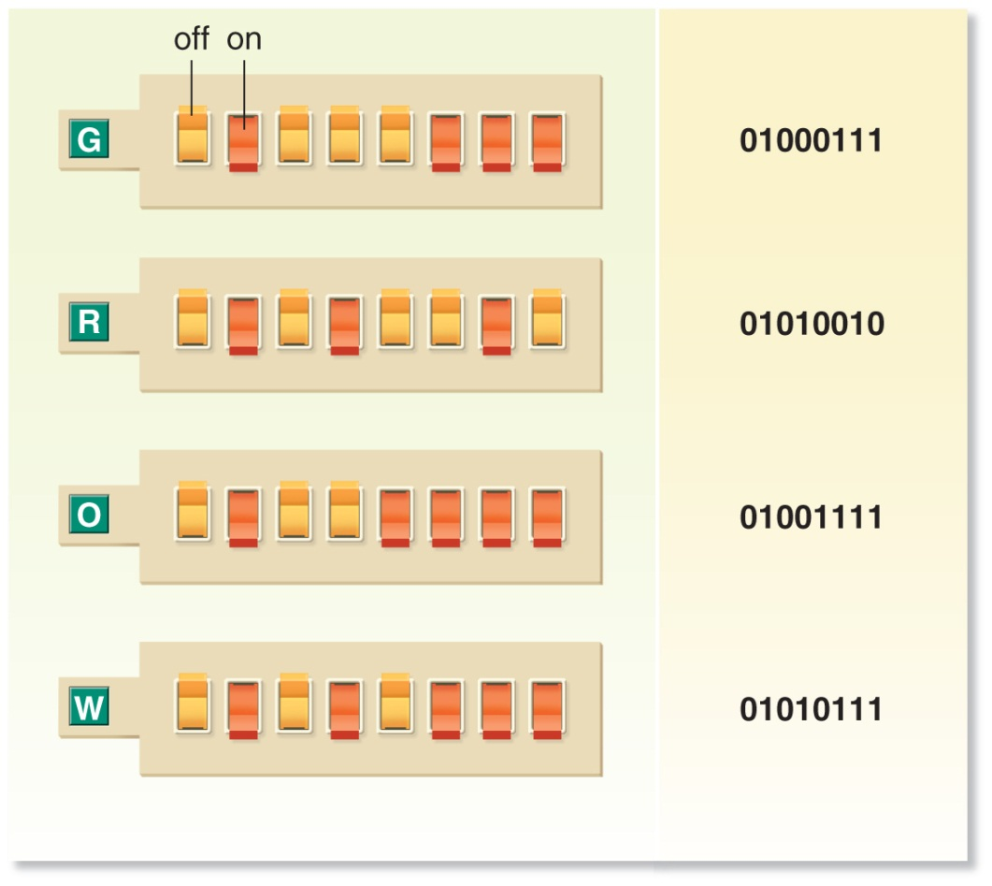
Binary System: the basic data-representation method for computers uses just two numbers: 0 and 1, representing the off/on states of electricity or light pulses.

Slide 5
Measuring Capacity
  All data and program instructions in the computer are represented as binary
  Bit: each 0 or 1 is a bit
  Byte: a group of 8 bits = 1 character, digit, or other value

Slide 6
Binary coding schemes assign a unique binary code to each character.
  ASCII
    Requires 7 or 8 bits per character, depending on the version
    8-bit Extended ASCII provides 256 characters
    Commonly used for microcomputers

Slide 7
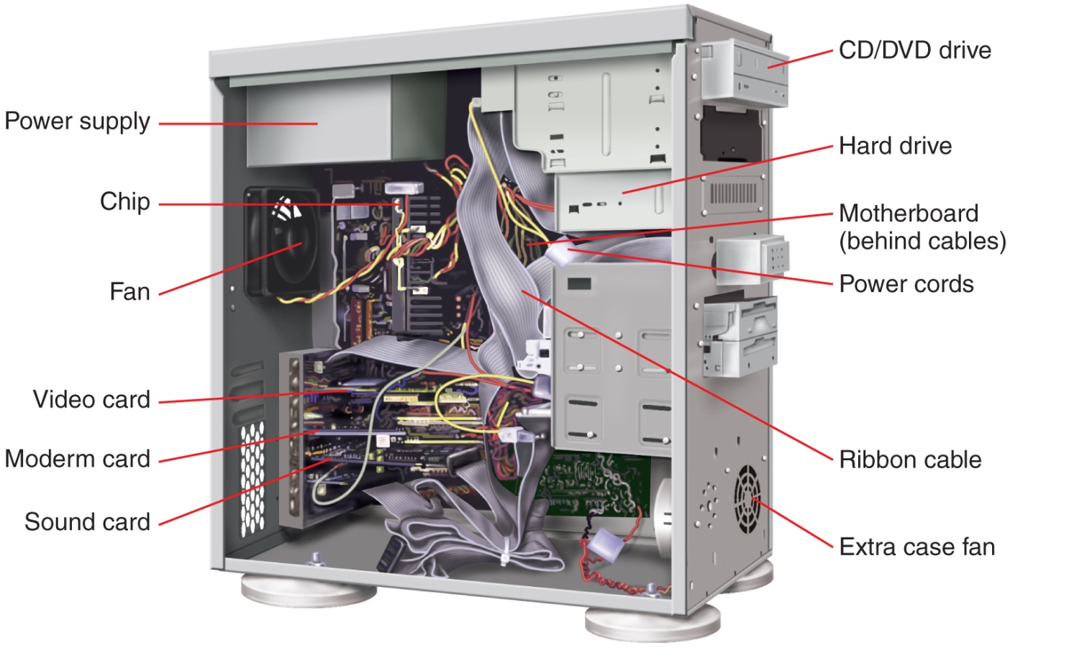
One View of a Motherboard

Slide 8
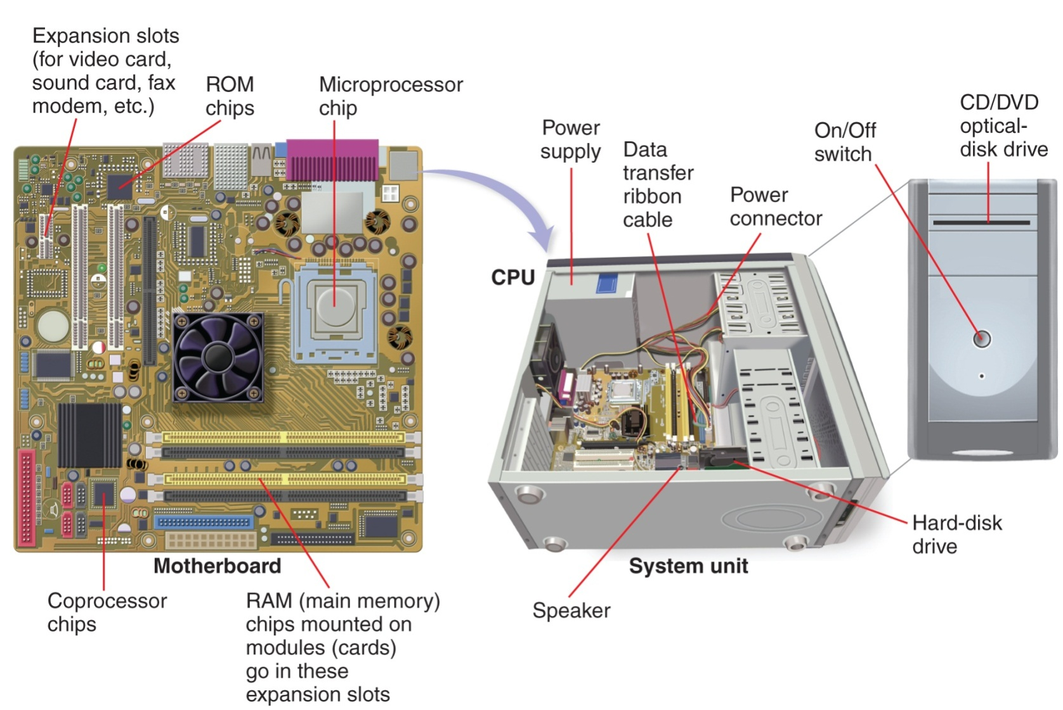
Another View of a Motherboard

Slide 9
Names
Definitions
Power Supply
UPS
Motherboard
Microprocessor
Chipset
This converts AC to DC to run the computer.
Uninterruptible Power Supply. Battery-operated device that provides power for a limited time when there is a blackout.
Main system board of the computer (also systemboard).
Miniaturized circuitry of a computer processor.
Groups of interconnected chips on the motherboard that control information flow between the microprocessor and other system components connected to the motherboard

Slide 10
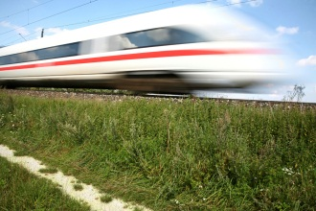
Processing Speeds
  Every microprocessor contains a system clock, which controls how fast all the operations within a computer take place (the chip’s processing speed).
  Older CPU processing speeds are in megahertz
    1 MHz = 1 million operations per second
  Current CPU processing speeds are in gigahertz
    1 GHz = 1 billion operations per second
  The faster a CPU runs, the more power it consumes, and the more heat it generates

Slide 11
4.2 More on the
System Unit
What Supports the Processor?

Slide 12
Parts of the CPU
Name
Word size
CPU
Control unit
Arithmetic Logic Unit (ALU)
Registers
Buses
Definition
The number of bits the processor can process at any one time
The central processing unit (chip) has two parts; the control unit and the ALU
The part of the CPU that deciphers instructions and carries them out
The part of the CPU that performs mathematical and logical operations
High-speed storage areas that temporarily store data during processing
Electrical data roadways used to transmit bits within the CPU and between CPU and other motherboard components

Slide 13
Memory
  Two type of storage: primary and secondary
    Primary storage = “memory,” “main memory,” “RAM”; this type of memory is temporary and volatile
    Secondary storage = “storage” disks and flash memory units; this type of memory is relatively permanent and nonvolatile

Slide 14
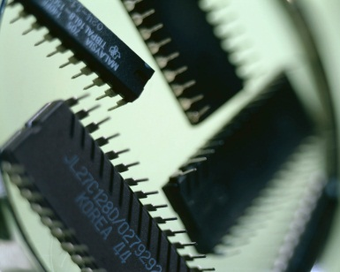
How Memory Works
Primary Memory Chips
RAM
ROM
Explanation
Random Access Memory chips are volatile and hold:
  Software instructions
  Data before & after the CPU processes it
Read Only Memory
  Cannot be written on or erased without special equipment
  Are loaded at factory with fixed (permanent) start-up instructions (BIOS), that tell the computer how to load the operating system

Slide 15
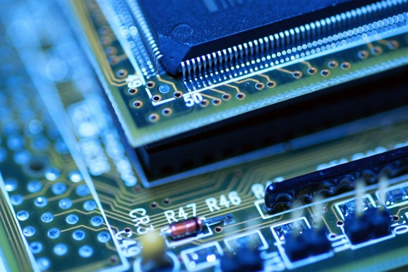
Speeding up Processing: Cache
  The CPU works much faster than RAM, so it often must wait for information
  Cache temporarily stores instructions and data that the processor uses frequently to speed up processing

Slide 16
A port is a connecting socket or jack on the outside of the computer unit or device into which are plugged different kinds of cables
Ports are used to connect peripheral devices

Slide 17
Port Type
Serial port
Parallel port
USB port
Description
Used to transmit data slowly over long distances
  Sends data sequentially, one bit at a time
  Used to connect older keyboards, mouse, monitors, dial-up modems
For transmitting data quickly over short distances
  Transmits 8 bytes simultaneously
  Connects printers, external disks, tape backups
Universal Serial Bus high-speed hardware standard for interfacing peripheral devices, such as scanners and printers, to computers. USB is replacing many varieties of serial and parallel ports.

Slide 18
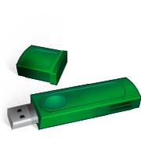
USB
  Goals
    Be low-cost
    Be able to connect lots of devices
    Be hot swappable
    Permit plug and play
      Devices are automatically configured when they are installed – no need to download new drivers

Slide 19
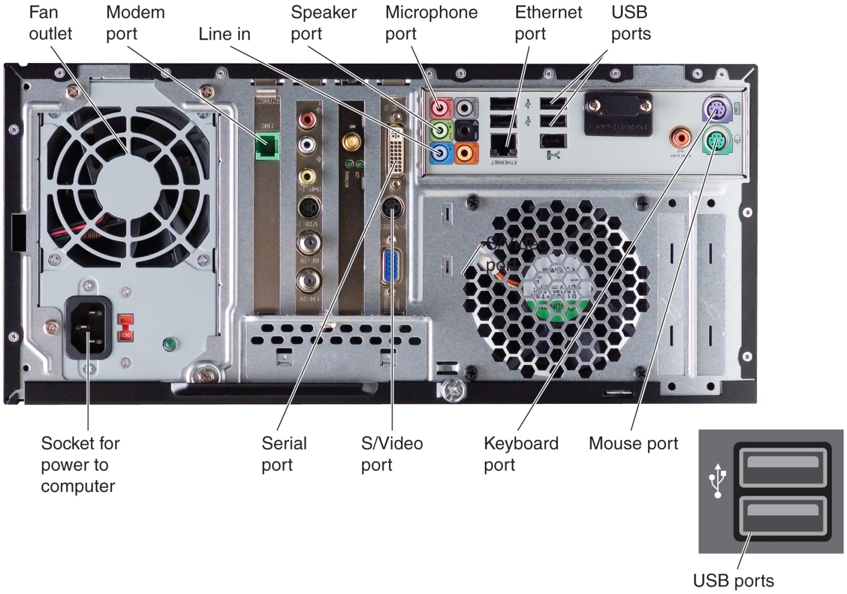

Slide 20
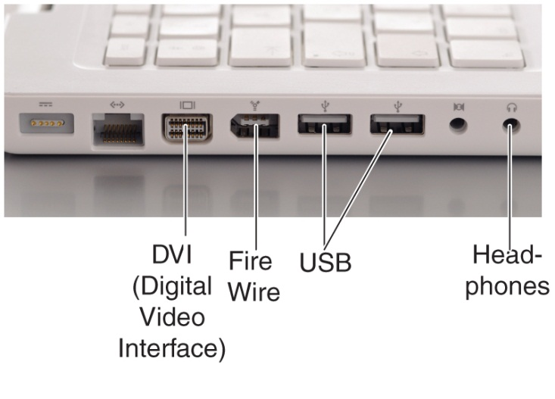
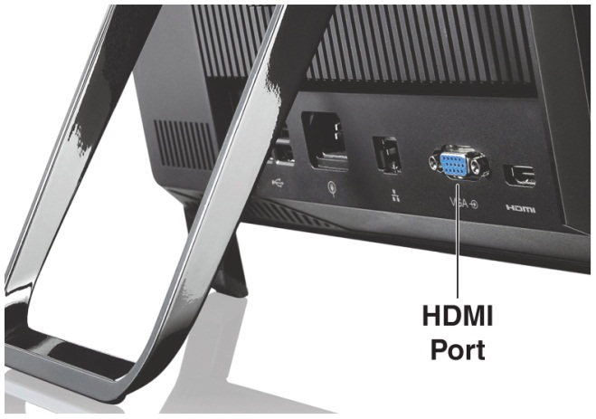

Slide 21
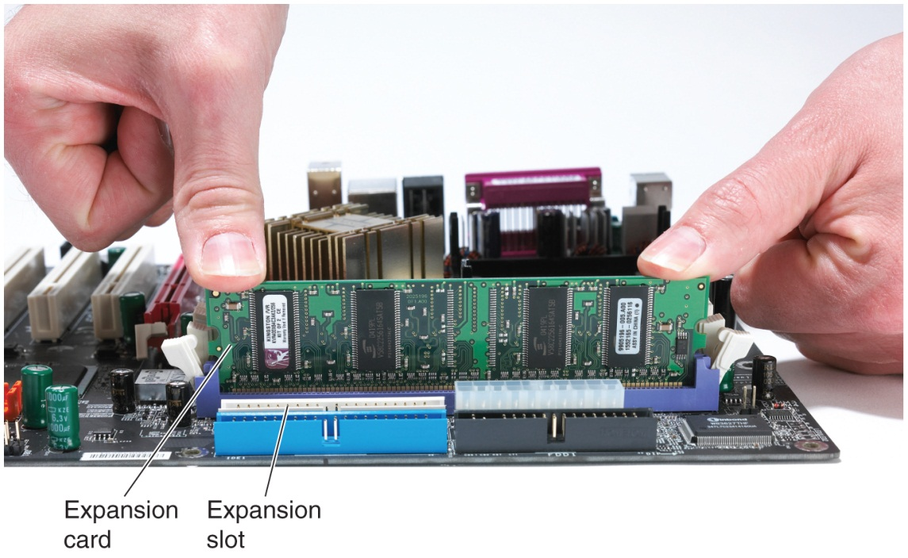
Expansion Cards: If a computer uses closed architecture, no expansion cards can be added; if the computer uses open architecture, expansion cards can be inserted in expansion slots inside the computer, connected to the motherboard.

Slide 22
Types of Expansion Cards
  Graphics cards (for monitors)
    Also called a video card, video RAM (VRAM), or video adapter
    Converts signals from computer into video signals that can be displayed as images on a monitor
  Sound cards (for speakers and audio output)
    Used to convert and transmit digital sounds through analog speakers, microphones, and headsets
  Modem cards (for remote communication)
  Network interface cards (for remote communication via cable)

Slide 23
4.3 Secondary Storage

Slide 24
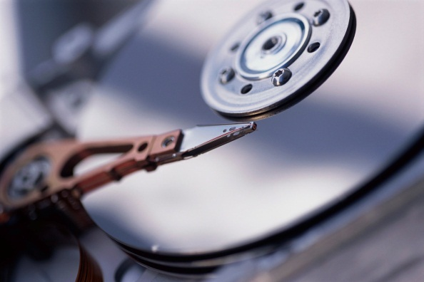
Hard Disks
  Thin, rigid metal, glass, or ceramic platters covered with a substance that allows data to be held in the form of magnetized spots
    The more platters there are, the higher the drive capacity
    Store data in tracks, sectors, and clusters
    Formatting creates a file allocation table that maps files to clusters.
    Important data should always be backed up!

Slide 25
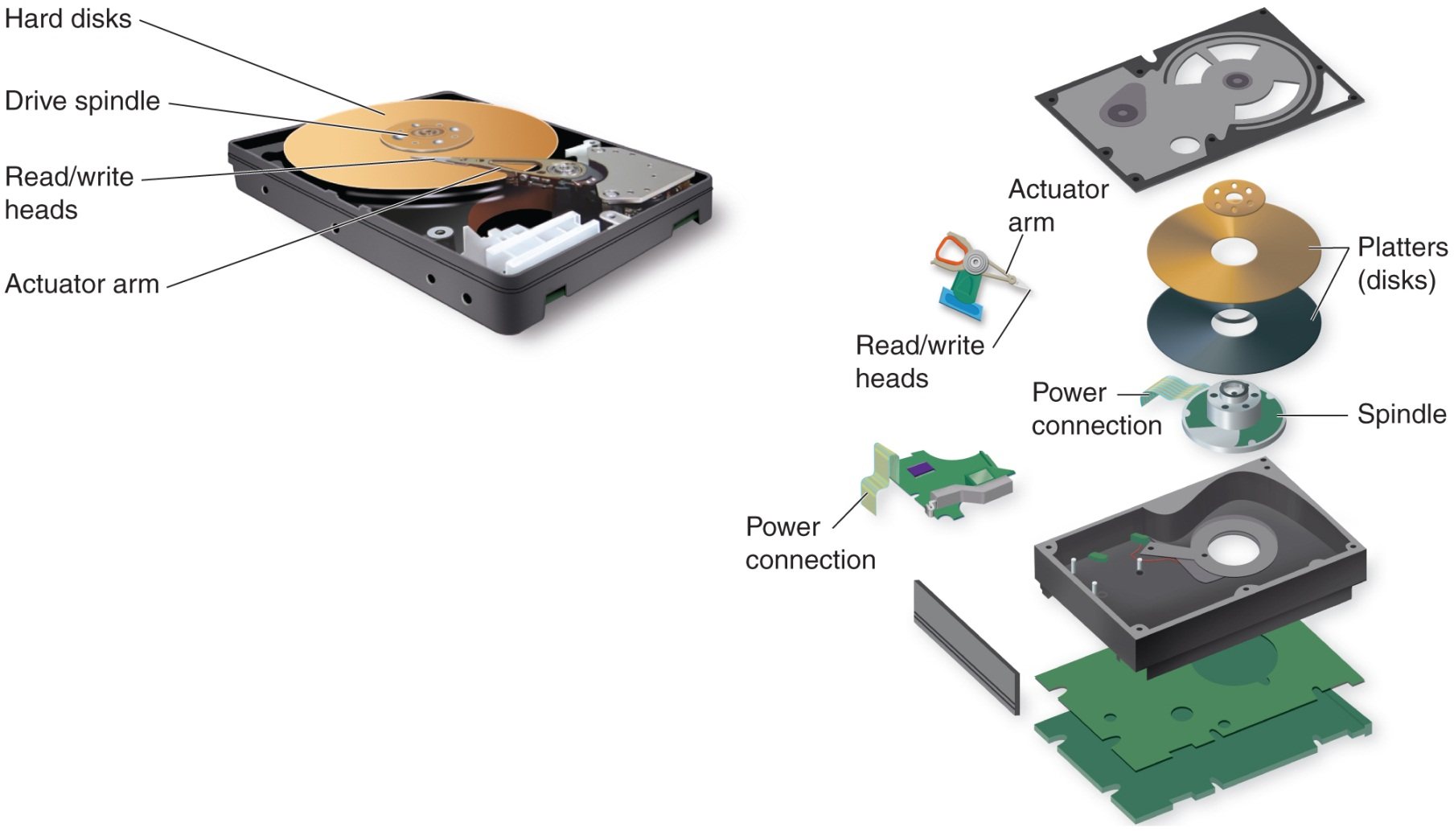

Slide 26
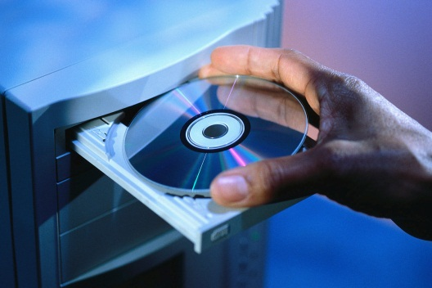
Optical Disks
  CDs (compact disks) and DVDs (digital versatile/video disks) are optical disks
  Data is written and read using lasers, not a disk read/write head
    CD-ROM is Compact Disk Read-Only Memory
    CD-R (compact disk-recordable) is used for recording only once
    CD-RW (compact disk-rewritable)is an erasable optical disk that can both record and erase data over and over again
    Blu-ray is an optical-disk format used to record, rewrite, and play back high-definition (HD) video, as well as to store large amounts of data.

Slide 27
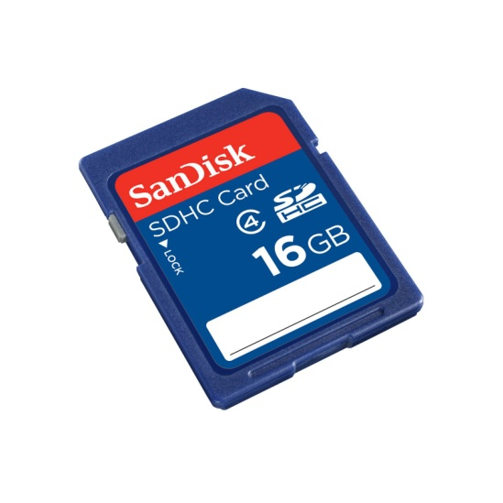
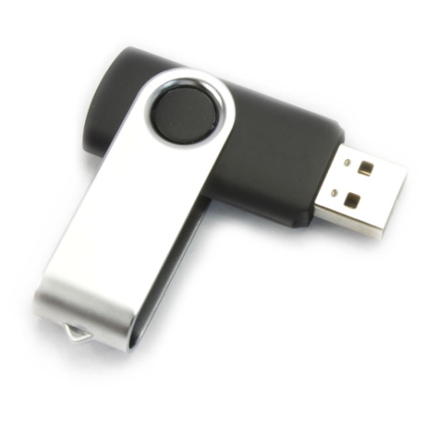
Flash Memory
  Nonvolatile memory with no moving parts
    Flash memory cards
      Insert these into a flash port of a camera, handheld PC, smartphone
    Flash memory drives (keychain drives)
        A finger-sized module of flash memory
        Plugs into a USB port

Slide 28

Online Secondary Storage (Cloud Storage)
  Allows you to use the internet to back up your data
    Sign up with a vendor and receive access to software and applications that allow you to upload your data to that company’s server

Slide 29
4.4 Input & Output

Slide 30


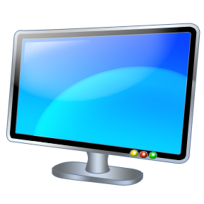
Input Hardware
  Devices that translate data into a form the computer can process
  Translates words, numbers, sounds, and pictures into binary 0s and 1s (off or on electrical signals or light pulses)
Output Hardware
  Devices that translate information processed by the computer into a form humans can understand
  Translates binary code into words,
  numbers, sounds, and pictures

Slide 31
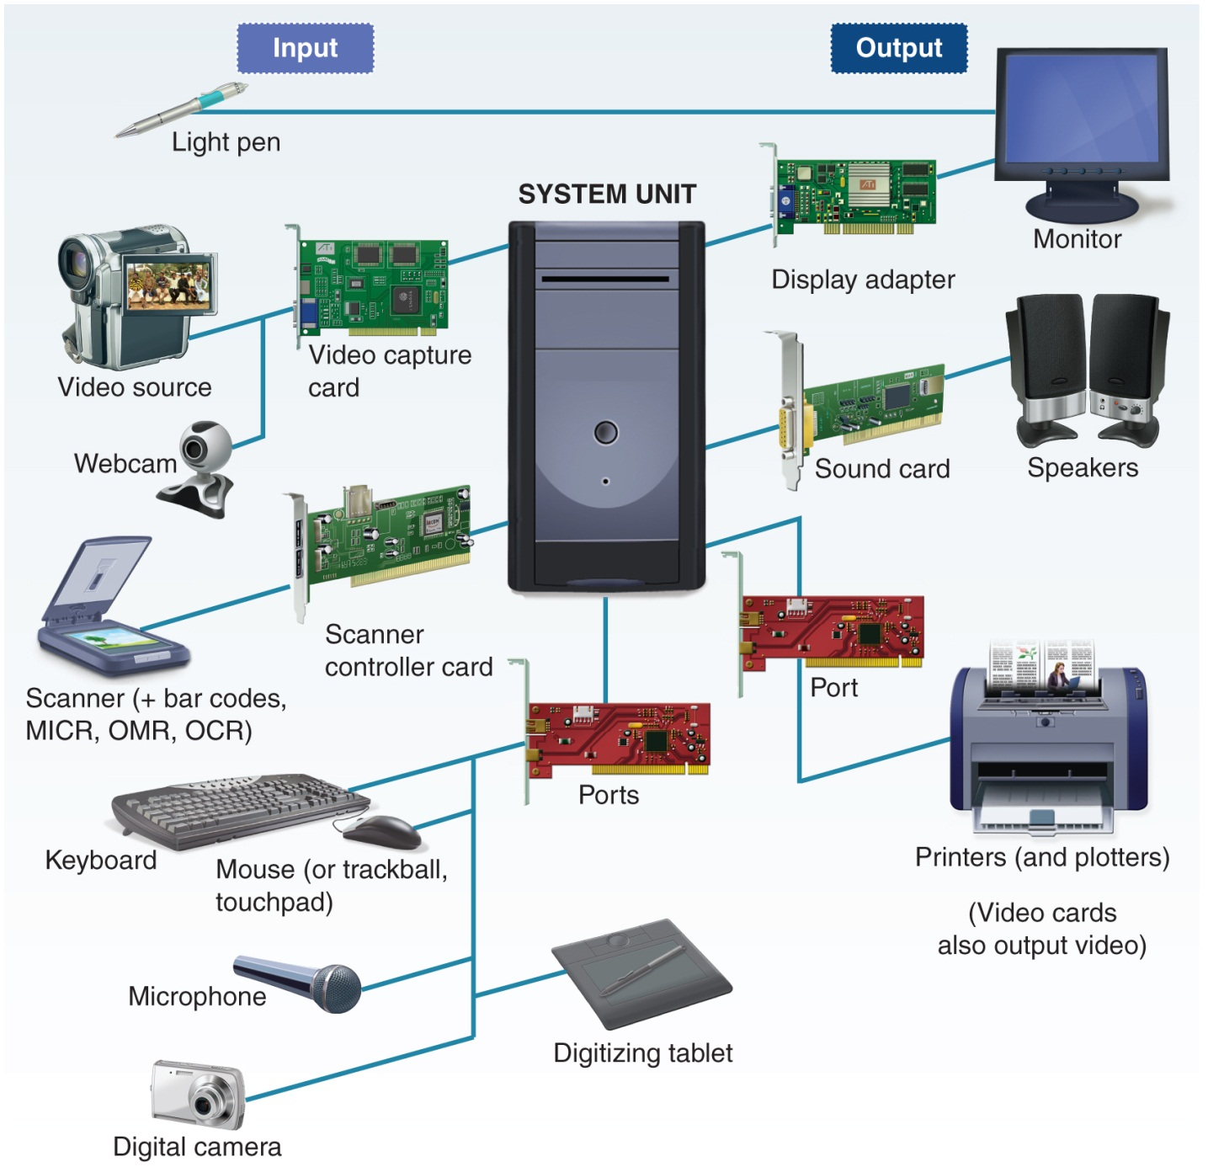

Slide 32
4.5 Input Hardware

Slide 33
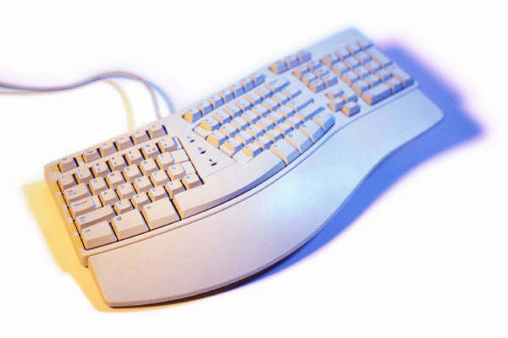
Keyboards: convert letters, numbers,
and characters into electrical signals
  English keyboards differ from foreign language keyboards
(continued)

Slide 34

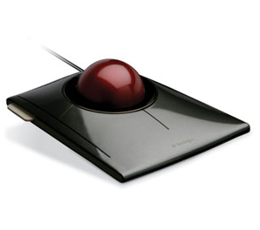
Pointing Devices
  Control the position of the cursor or pointer on the screen and allow the user to select options displayed on the screen
  Mouse is the principal pointing device
    Mechanical mouse: a ball inside the mouse touches the desktop surface and rolls with the mouse
    Optical mouse: uses laser beams and special chips to encode data for the computer
  Trackball
    A movable ball mounted on top of a stationary device
    Good for locations where a mouse can’t move around enough
  Touchpad
    To use: slide your finger over this small flat surface
    Click by tapping you finger on the surface
    May require more practice to use than a mouse
    Used on laptops

Slide 35

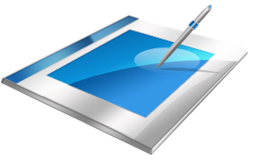
Pointing Devices (continued)
  Touch Screens
    A video display screen sensitized to receive input from a finger touch
    Often used in ATMs, information, kiosks, reservation kiosks, voting machines, cellphones, and e-books
  Pen input
    Uses a pen-like stylus for input
    Uses handwriting recognition to translate cursive writing into data (handwriting recognition)
  Digitizer
    Uses an electronic pen or puck to convert drawings and photos to digital data
    Digitizing tablets are often used in architecture

Slide 36
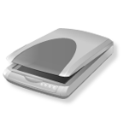
Scanning & Reading Devices—Source data-entry devices that create machine-readable data and feed it directly into the computer (no keyboard is used)
  Scanners
    Use light-sensing equipment to translate images of text, drawings, and photos into digital form
    Image scanners are used in electronic imaging
    Resolution refers to the image sharpness, measured in dots per inch (dpi)

Slide 37
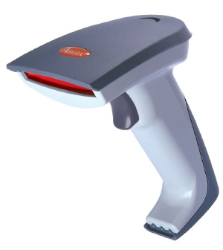
  Bar-Code Readers (source data entry)
    Photoelectric (optical) scanners that translate bar code symbols into digital code
      The digital code is then sent to a computer
      The computer looks up the item and displays its name and associated information

Slide 38
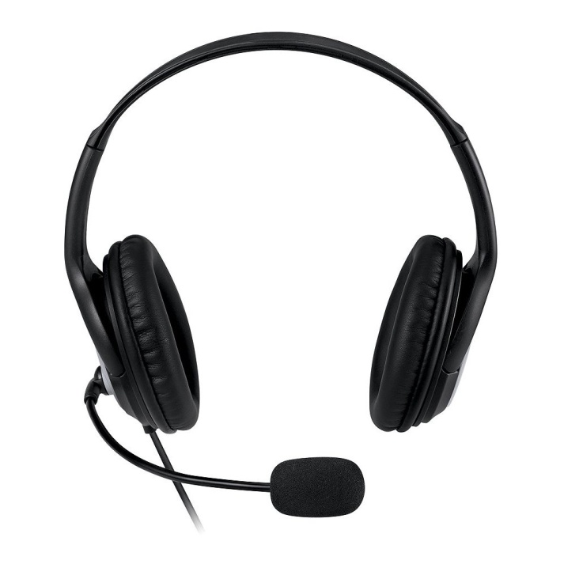

Audio Input Devices
  Record analog sound and translate it into digital files for storage and processing

Slide 39
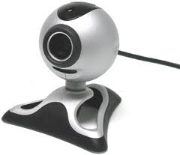
Video Input Devices
  Webcams
    Video cameras attached to a computer to record live moving images then post them to a website in real time
    Require special software, usually included with the camera

Slide 40
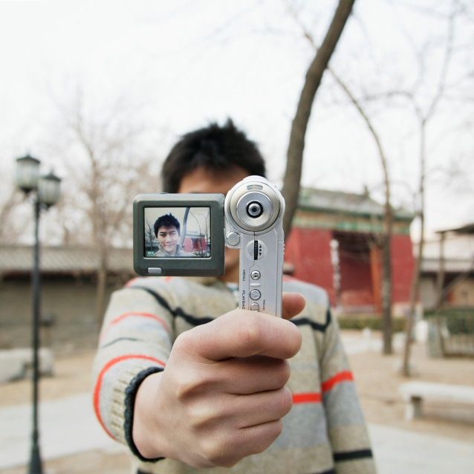

  Digital Cameras
    Use a light-sensitive processor chip
    to capture photographic images in digital
    form and store them on a small diskette
    in the camera or on flash memory cards
      Most can be connected to a PC by USB or FireWire
      Allows you to take many pictures and decide which ones to save, email, and/or print
  Camera Phones
    Digital cameras are now on cellphones
    Convenience of being able to take photos, then instantly email or message them to someone else

Slide 41
Speech-Recognition Systems
  Use a microphone or telephone as an input device. Converts a person’s speech into digital signals by comparing against 200,000 or so stored patterns.
    Used in places where people need their hands free – warehouses, car radios, stock exchange trades
    Helpful for people with visual or physical disabilities that prevent them from using other input devices

Slide 42
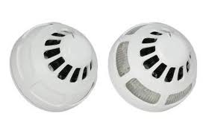
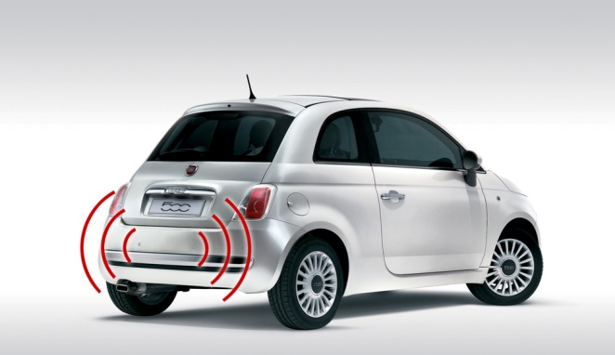
Sensors
  Input device that collects specific data directly from the environment and transmits it to a computer
  Can be used to detect speed, movement, weight, pressure, temperature, humidity, wind, current, fog, gas, smoke, light, shapes, images, etc.

Slide 43
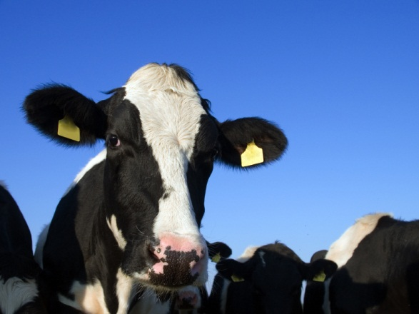
RFID Tags
  Radio-frequency identification (RFID) tags have a microchip that contains specific code numbers
    Scanners use radio waves to read the code numbers and match the codes to a database
    Enables items to be tracked without physical contact
      Drivers put RFID tags in cars to automatically pay tolls
      FDA is tagging certain drugs with RFID to avoid counterfeits
      Carmakers are using it for car electronic keyless entry
      RFID tags are implanted under skin of pets to aid in recovery and identification when they get lost

Slide 44
4.6 Output Hardware

Slide 45
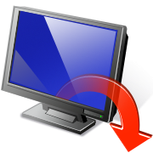

Softcopy
  Data that is shown on a display screen or is in audio or voice form; exists electronically
  Is not tangible, is impermanent
Hardcopy
  Relatively permanent—printed
  and film output

Slide 46
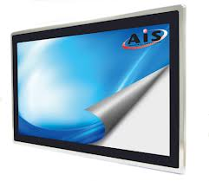
Display Screens (Softcopy Output)
  Also called monitors
      Resolution refers to the image sharpness
      The more pixels, the better the resolution
      Expressed in dots per inch (dpi)

Slide 47
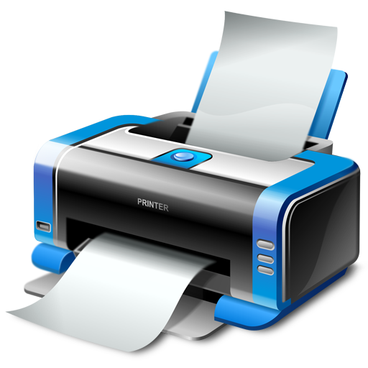
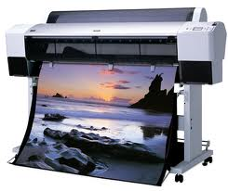
Printers & Plotters (Hardcopy Output)
  Printers print text and graphics on paper or other hardcopy materials
  Printers are either impact or nonimpact
    Impact printers (dot-matrix printer) print by striking the paper directly;
    Nonimpact printers (such as laser printers and inkjet printers) do not have direct contact with the hardcopy medium

Slide 48
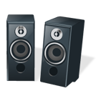
Sound, Voice, & Video
  Sound output—produces digitized sounds, even “3-D” sound
    You need a sound card and sound software
    Good speakers can improve the sound
  Voice output—converts digital data into speechlike sounds
    Used in phones, cars, toys and games
  Video output—photographic images played quickly enough to appear as full-motion
    Requires powerful processor and video card
    Video files are large, so a lot of storage is needed, too.
    Videoconferencing is a form of video output

Slide 49
4.7 The Future of Input & Output

Slide 50

Future improvements in input/output could include:
  Intelligent sensors
  Input help for the disabled
  More sophisticated touch devices
  Better speech recognition
  Improved digital cameras
  Gesture recognition
  Pattern recognition
  Reducing printer ink usage
  3-dimensional output

